Slide 1
Deep Learning Tutorial 3

Slide 2
Outline
Dataset
Train
Evaluation
Useful Label Tool: Labelme

Slide 3
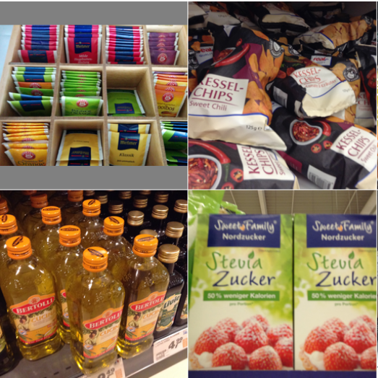
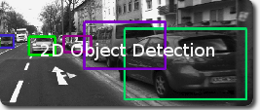
Dataset preparation
Define the purpose
Classify object: give each image a label
Detect object: label image with a bounding box
Define environment (scenario)
The environment will influence the model property
Illuminance, Clutter, background
How to prepare the dataset
Survey whether there is dataset available
Generate dataset by ourselves
Grocery Dataset
KITTI Dataset

Slide 4
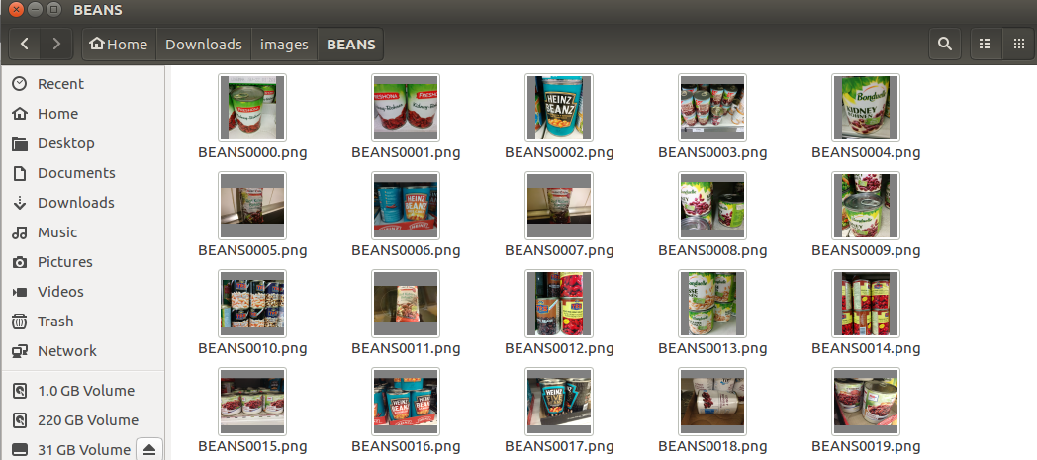
Dataset format
Classifier:
The same label image will be located in the same folder

Slide 5
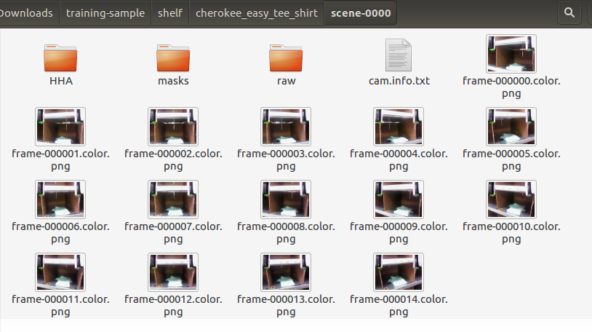
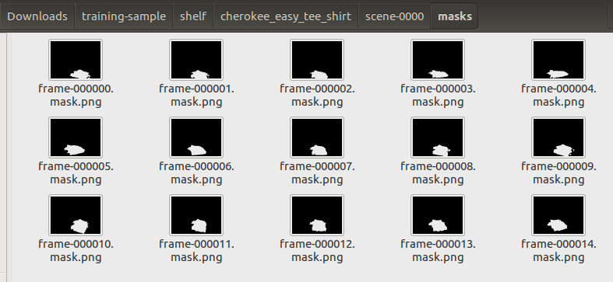
Dataset format
Detector
Image folder with a corresponding mask folder

Slide 6
Load dataset
A useful pytorch tool to load dataset: “ImageFolder”. It helps us finish:
Load images and their corresponding labels
Image preprocessing
Normalize
Resize
Flip
Crop

Slide 7
Train a model
Step 1. Define a network
Step 2. Load training and testing dataset
Step 3. Tune the training parameter and start to train
Epoch
Batch size
Learning rate

Slide 8
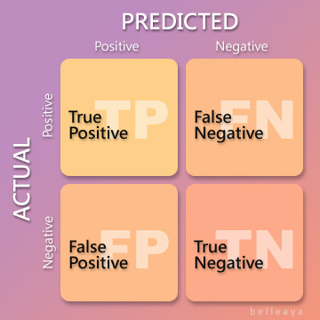
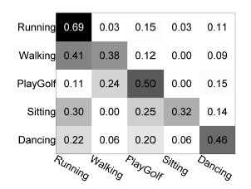
Evaluation (Confusion matrix)

Slide 9
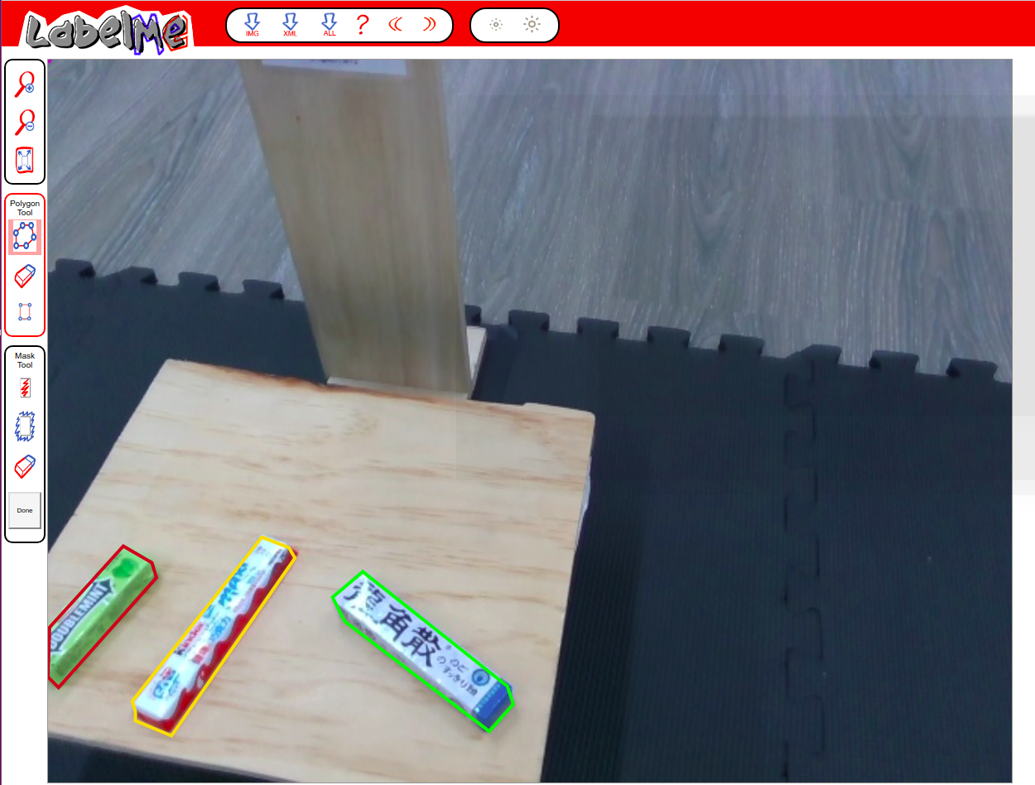
Useful Label tool: Labelme
An online annotation tool to build image database
Used for label image bounding box or polygon

Slide 10
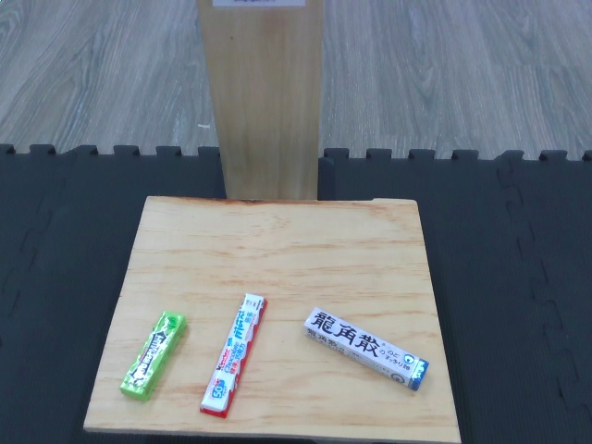
Mini competition dataset
Purpose
Detect 3 products
Environment (Scenario)
Products will be on the platform. Different illuminance, clutter may happen
How to prepare the dataset
No dataset available ⇒ Generate dataset by ourselves

Slide 11
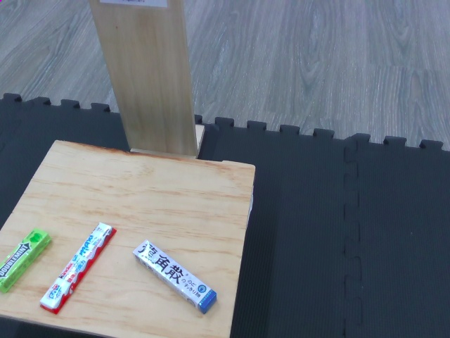
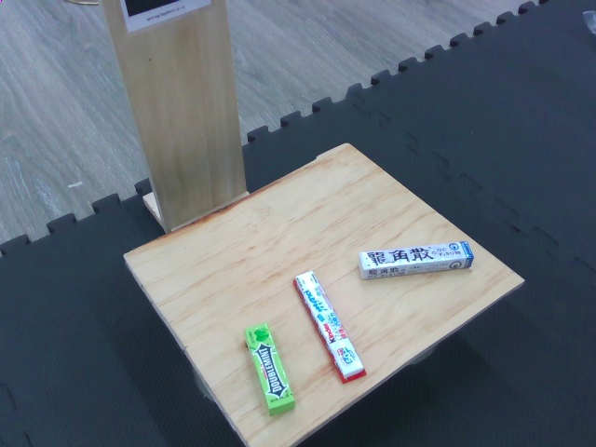
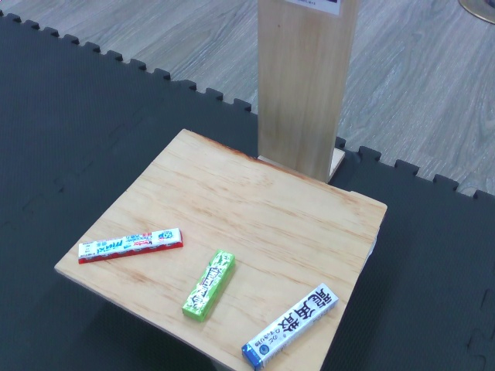
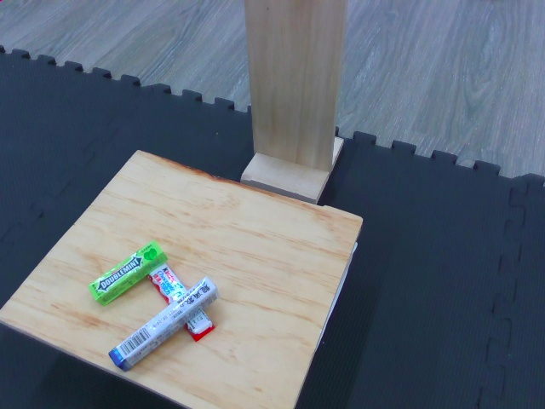
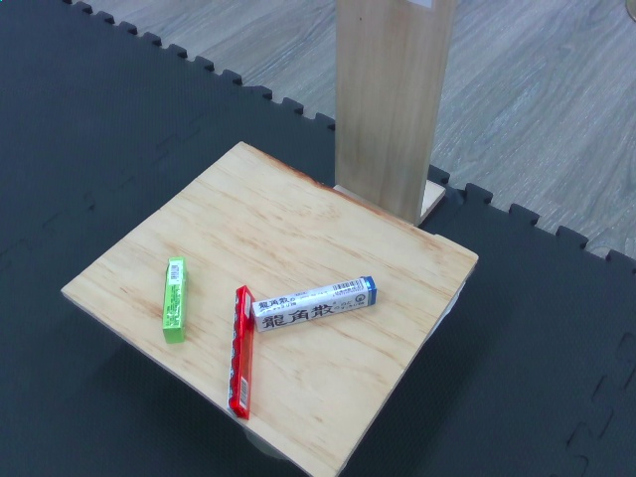
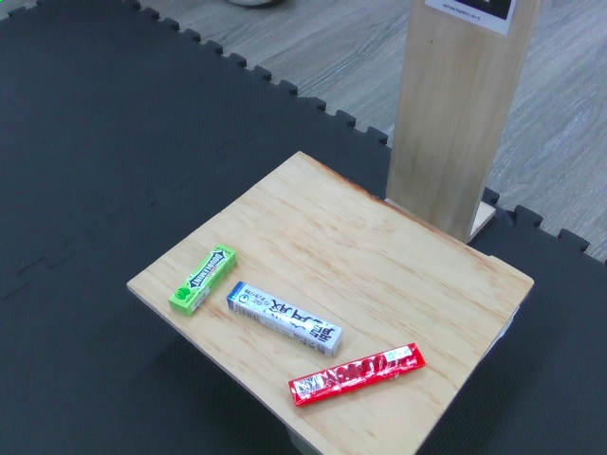
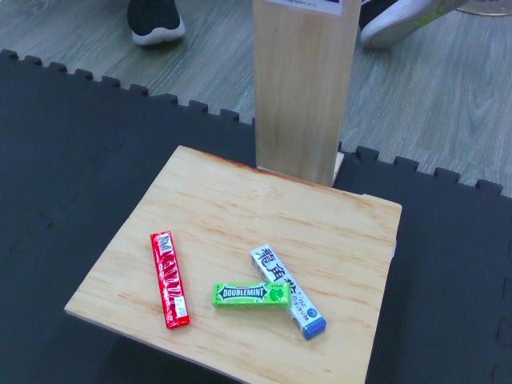
Mini competition dataset
Collect method:
About 18 viewpoint
Multi product placing method
Different point of view
41 scene

Slide 12
Let’s start the tutorial

